Slide 1
Power Management

Slide 2
Contents
Power Management Introduction
Hardware / Software Interaction
Test function coverage
System Hierarchy of Power Management
G-States
C-states
S-states
D-states
L-State
P-State

Slide 3
So What’s Power Management ?
Mechanisms via software or hardware to minimize system power consumption.
Manage system thermal limits
Maximize system battery life
Power management involves trade-offs
system speed
processing speed
battery life
Alternating current (AC) power consumption.

Slide 4
Introduction
What is CPU Power Management?
Save power when the processor is idle – Sleep States
Not executing any instruction or doing any work
Save power when the processor is executing – Performance States
Has less load than it can handle in active state
Perform effective thermal management – Thermal Monitor
Protect CPU against extreme thermal conditions
Get optimal performance when CPU is running hot
Focus is now towards performance per watt, i.e. getting the most work out of the CPU within a specific power and thermal envelop.

Slide 5
Continue..
Why is Power Management important?
Notebook Computers
Power usage of notebook computers determine battery life
Higher power use increase weight for larger batteries, heat sinks and shielding
Battery replacement can be a significant expense
Server Farms
Large server farms are like heavy duty factories
Operating expense depends on electrical power consumption
Fans, thermal heat sinks, shielding increase the total cost of systems
Embedded Processors
Always very cost sensitive, and often weight sensitive; don't want to pay for heat sinks, and thermal shielding.
Often battery powered and cannot be actively cooled by fans: cell phones, portable media devices, handheld devices etc.

Slide 6
ACPI Standard
ACPI Specifications
ACPI - Advanced Configuration & Power Interface
Industry standard created by Intel, Microsoft, Phoenix, Toshiba and Compaq
http://www.acpi.info/spec.htm
Conserve energy by transitioning unused devices into lower power states.
Includes placing the entire system in a low-power state when possible.
Combination of OS, BIOS, and Hardware to support low power.
ACPI low power states are:
G-States – Global system states:
G0-active, G1-sleep, G2-soft off, G3-mech off
S-States – Global Sleeping states:
S1, S2, S3, S4, S5 (within G1)
D-States – Device states (i.e. Monitor, Modem, Drives)
C-States – CPU Sleep States – Reduces Idle Power (within G0)
L-States – Link States -- Reduces power of the Bus
P-States – CPU Performance States – Reduces Active Power (within C0)

Slide 7
Hardware / Software Interaction
ACPI, software, and hardware all play a role here
ACPI
Describes power management capabilities of the system.
Describes what interfaces to use to utilize these power management capabilities.
ACPI is abstract so that software (OS) can evolve separately from the hardware and likewise, the hardware from software.
The interface Interacts to hardware and OS with the help of ACPI tables that get generated by BIOS/Firmware every time it gets loaded.
Software (OS)
Reads ACPI tables during initialization to discover power management capabilities.
Requests different power management states using the ACPI defined interfaces.
Software utilizes general activity based policies (utilization, bandwidth, ...) to make decisions.
PPM engine(Platform Power Management), Linux governors
Software utilizes activity based policies in some cases too (audio playback, ...).

Slide 8
Continue…
Hardware
Hardware responds to software (OS) requests
Hardware may not always honor what the software requests
May choose a different state for performance, energy efficiency, or thermal reasons
Many power management features are controlled autonomously in hardware
These are not exposed to software

Slide 9
System Hierarchy of Power Management under ACPi
Power Management states and required functionality are defined for multiple levels of the system
– Global view: Gx states (User View )
– System: Sx states
– Processor: Cx states
– PCI Express Links: Lx states
– Devices: Dx states
General Trend of the state numbers
0 is the Active state - G0, S0, D0
System is available to User
1-n are sleep states
higher number corresponds to lower power.
User perception is OFF for all of these sleep states.

Slide 10
Global System States
G-States
G-states reflects the User’s perception of the machine.
G0 Working (S0)
A computer state where the system fully operational.
It is not safe to disassemble the machine in this state.
G1 Sleeping ( S1-S4)
Power consumption is small and the system “appears” to be off.
Work can be resumed without rebooting the OS.
Large elements of system context are saved by the hardware and the rest by system software.

Slide 11
Continue..
G2 Soft Off (S5)
The computer consumes a minimal amount of power.
This state requires a large latency in order to return the Working state.
The system’s context will not be saved. The system must be restarted.
G3 Mechanical Off
This state that is entered by a mechanical means (i.e. power switch).
The OS must be restarted and no hardware context is retained.
Except for the real-time clock, power consumption is zero.

Slide 12
Power States
C-State
C-states are an idle processor state entered when a processor is halted
Depending on the architecture / product they range from C1 – C7
C-states save a significant amount of power; C6 is close to 0 W for core power
C-states exist at the thread, core, and package level
All threads per core must be in a Cn before the core enters core Cn (ccn)
All cores per system must be in a Cn before the packages can enter package Cn (pcn)
Latencies
Penalties associated with deep c-states – in exiting state we need to ramp frequency/voltage, restore core state
Can result in performance degradation on some workloads
Can result in power increase if used inefficiently
A feature called auto-demotion detects scenarios with likely performance impact and reduces use of deep c-states

Slide 13
C0 State
CPU fully turned on.
This is the CPU's maximum working state where it is actively accepting instructions and processing data.
Power saving is virtually zero.
C1 State
It is simply done by executing the assembly instruction “HLT” (Halt).
This will stop the instruction pipeline within the CPU from executing any instructions.
Stops CPU main clock via software but Bus Interface unit and APIC(Interrupt Controller) keep running.
Wake-up time is ultra fast (only about 10 Nano seconds).
The CPU is able to save up to 70% of its maximum power consumption.
All modern processors support this power state.
C2 State(Stop Grant)
The processor core clock and platform I/O buffers are gated.
The transition time from C2 to C0 is 10 times more then that of C1(~100 Nano seconds).

Slide 14
C3 State(Deep Sleep)
The bus clock and PLLs are gated.
In a multi-processor system, the processors no longer handle FSB(Front Side Bus) snoops to maintain cache coherency. Cache contents are invalidated that means cache is no longer accessible.
CPU still saves around 70% power.
Wake up time is 500 times longer than C2 (about 50 micro seconds).
C4 State(deeper Sleep)
It is similar to the C3 state, but with two main differences.
First, the core voltage is reduced to a very low level (less than 1.0V) to decrease current leakage.
Second, data stored in the L2 cache will be reduced bit by bit over time.
The CPU can save around 98% of its maximum power.
C5 State
When the data in the L2 cache is reduced to zero.
Wake-up time is more than 200 micro seconds.

Slide 15
C6/C7 State
New power management feature
When the L2 cache contents are shrunk to zero, the CPU will go into an even lower core voltage.
CPU context is no longer preserved.
Power consumption is virtually near zero.
Intel Haswell onwards Intel’s Processors weighted new and improved features which help them to maintain a low power draw without sacrificing much of their performance.
New C-States have been Introduced i.e. C-8, C-9, C-10

Slide 16
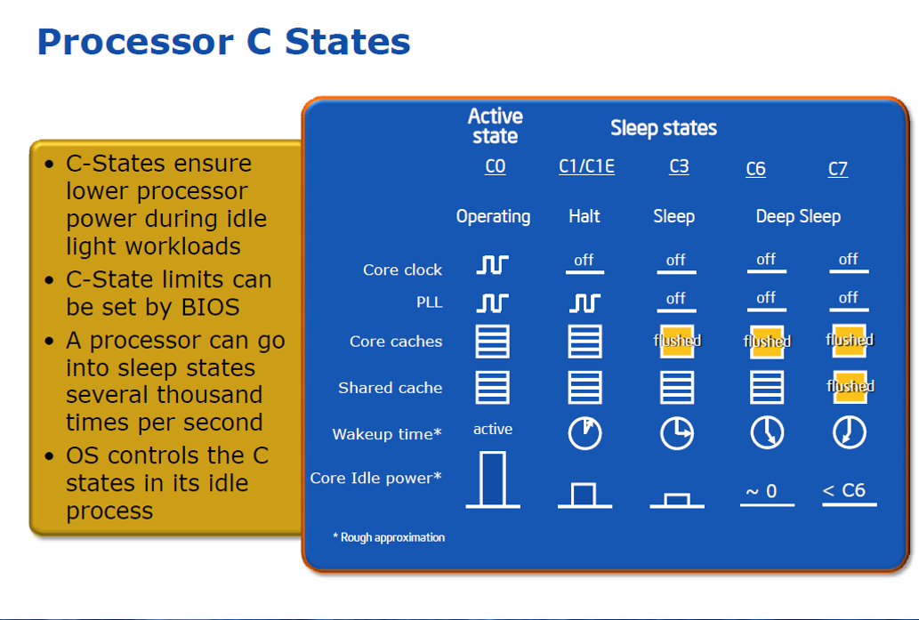

Slide 17
S-State
S1 State
The system consumes less power than S0 state. All Hardware & Processor context is maintained.
S2 State
The system consumes less power than S1 state. Processor loses power and processor context and contents of the cache are lost.
S3 State
The system consumes less power than S2 state.
In this state, RAM is still powered, although it is almost the only component that is.
Since the state of the operating system and all applications, open documents, etc. lies all in main memory, the users can resume work exactly where they left.
The computer is faster to resume than to reboot, secondly if any running applications have information this will not be written to the disk.
This state is comparatively more common.

Slide 18
S4 state
The system consumes the least power compared to all other sleep states.
In this state, all content of main memory is saved to non-volatile memory such as a hard drive, preserving the state of the operating system, all applications, open documents etc.
That means that after coming back from S4, the user can resume work where it was left off in much the same way as with S3.
The difference between S4 and S3, apart from the added time of moving the main memory content to disk and back, is that a power loss of a computer in S3 makes it lose all data in main memory.
S5 State
The system is in a shutdown state and the system retains no context.
Note that in power state S4 the system can restart from the context data stored on the disk But in S5 the system requires a reboot.

Slide 19
D-states (device states)
Low power device states for a device or subsystem
Combination of software initiated and controlled autonomously in hardware
D0 (full on)
Device is on and running.
It is receiving full power from the system and is delivering full functionality to the user.
D1(Low on)
Power consumption is lower than the D0 state, as some working units in the device will shut down.
Example : After idling for some time, the laser in the Optical Mouse will automatically turn off/Dim, but the drive controller will still be active.
D2 State
It is similar to D1, but the bus is free to some power management, like lower the current and voltage.
Not Applicable/Defined to all Devices

Slide 20
D3 State
The device in this state can be completely turned off.
Maximum power saving is achieved.
D3 Cold
D3 cold is the lowest-powered sub state of D3.
Moving idle devices to the D3 cold sub state can reduce power consumption and extend the time that a mobile hardware platform can run on a battery .
D3 cold, the main power source is removed from the device.
D3 Hot
D3 hot, the device is almost turned off.
However, the device is not disconnected from its main power source.
The parent bus controller can detect the presence of the device on the bus.

Slide 21
Link power States
PCI Express Link Power States
L0 –Fully Active
L0s –Electrical Idle (Autonomous)
Low exit latency (<1 μs).
Reduces power during short intervals of idle.
Devices must be in transition to L0s independently on each direction of the link.
L1 –Electrical Idle (Directed from higher layer)
Lower exit latency (~2 -4 μs).
Reduces power when the device becomes aware of a lack of outstanding requests or pending transactions.
The power-saving opportunities include, but are not limited to:
Shutdown of almost all the transceiver circuitry.
Shutdown of the PLL.

Slide 22
Continue…
L2/L3 Ready
Prepares the PCI Express link for the removal of power and clock.
The device is in the D3hot state and is preparing to enter D3cold.
L2
This link state is intended to comprehend D3cold with Aux power support.
WAKE# signal used for wake-capable devices to exit this state.
L3 (link off)
Power and clock are removed in this link state.
No Aux power available.
To exit this state, the platform must go through a boot sequence where power, clock, and reset are reapplied.

Slide 23
P-state
An core operating point specified by a specific frequency and voltage
Processor switches between these states dynamically to save power
P in P-States stands for performance
a.k.a. EIST(Enhanced Intel Speed Step Technology, GV3, DBS(Demand Base Switching).
Running a processor at high clock speeds allows for better performance
OS initiates transitions between p-states based on processor utilization
OS thread level p-state requests may be coordinated by the CPU; selecting a single p-state for all active cores in the package
Range of p-states
P0 – turbo frequency
P1 – highest frequency Mode (HFM) – this the marked frequency
P2 ... Pn+1
Several steps of p-states small frequency increments
Pn – lowest frequency Mode (LFM)

Slide 24
P-state(turbo)
Turbo mode converts power or thermal headroom into higher frequencies.
Boosts processor frequency when a processor operates below a set of constraints.
Frequency is limited to stay below temperature, power, and current limitations
It’s possible for turbo to exceed these limits for a limited amount of time
Turbo upside is limited by the number of ‘active’ cores
Idle cores, particularly cores in C6 provide more power budget for active cores to run faster
Increasing the number of idle cores (cores in C3/C6) saves a great deal of power) and gives you additional turbo upside
Power budget can also be used to increase frequency of integrated subsystems (graphics, ...)

Slide 25
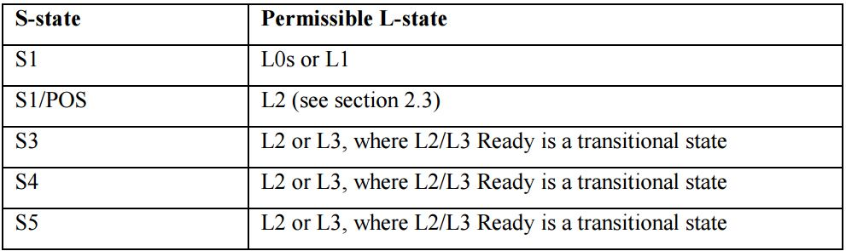
Relation Between S-state and L- state

Slide 26
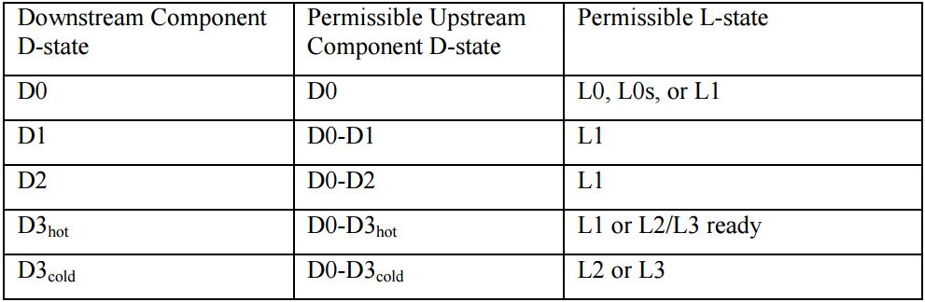
Relation Between D-state and L- state

Slide 27


